Slide 1
Chapter 5
Identifying Good Measurement

Slide 2
Reminders
Chapter 5 Assignments due September 30th at 11:59 pm
  Ebook: Chapter 5
  InQuizitive: Chapter 5

Slide 3
Agenda
Ways to Measure Variables
Reliability
Validity
Next time on PSY 270…

Slide 4
Ways to Measure Variables
Conceptual and Operational Definitions
Common Types of Measurement
Scales of Measurement

Slide 5
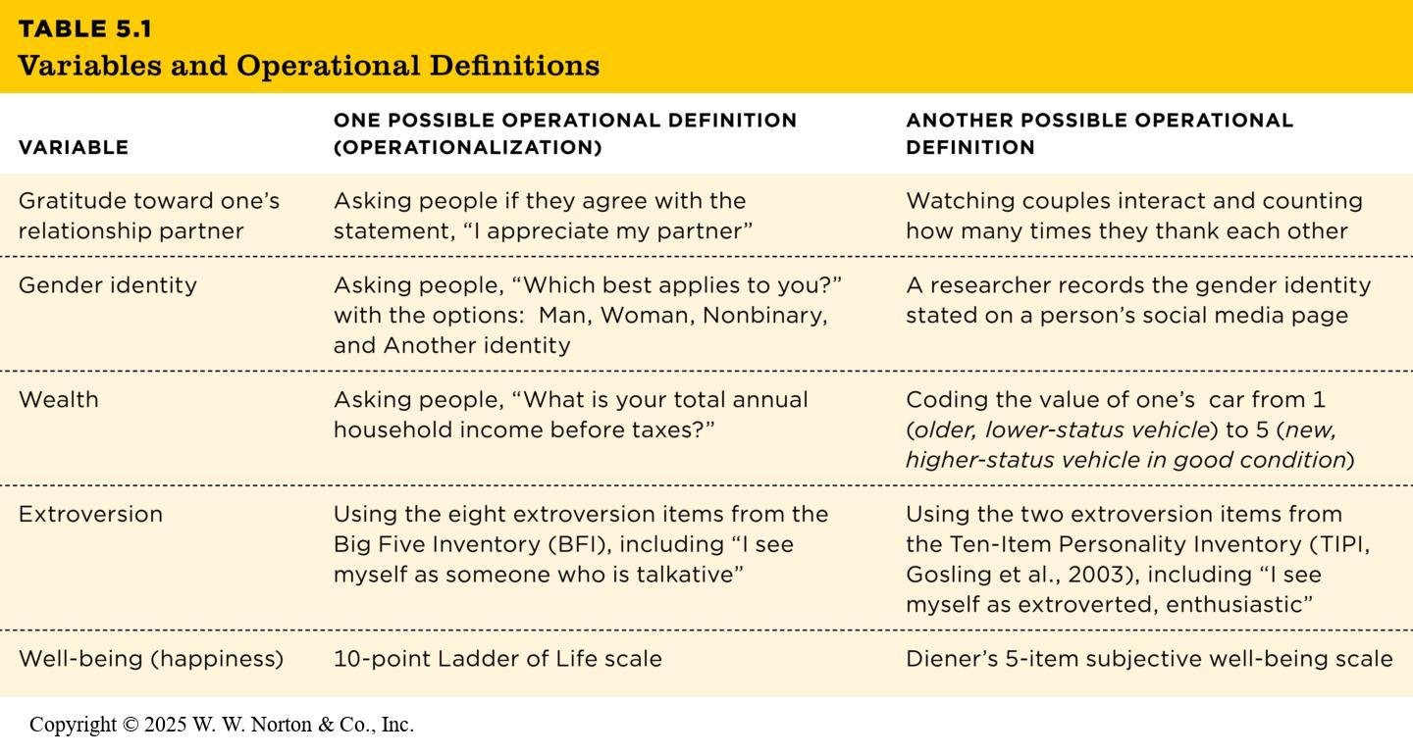
Conceptual and Operational Definitions Review

Slide 6
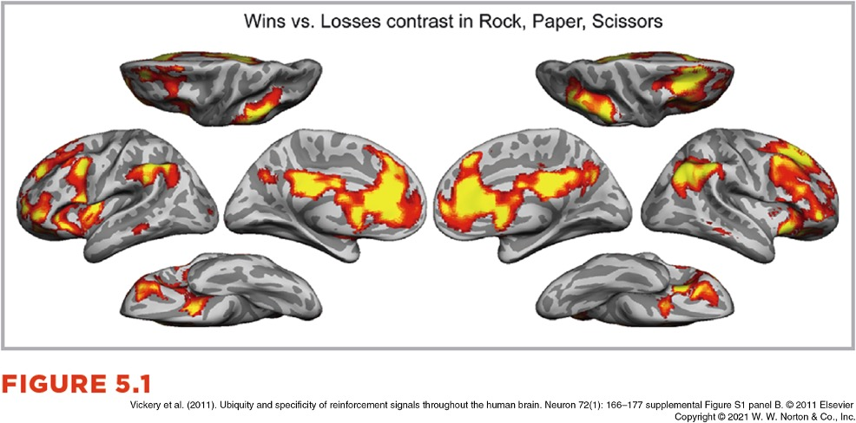
Three Common Types of Measures
Self-report measures
Observational measures
Physiological measures

Slide 7
Talk It Out:
Measuring Stress
How could we conceptually define stress?
What might a self-report measure look like?
What might an observational measure look like?
What might a physiological measure look like?

Slide 8
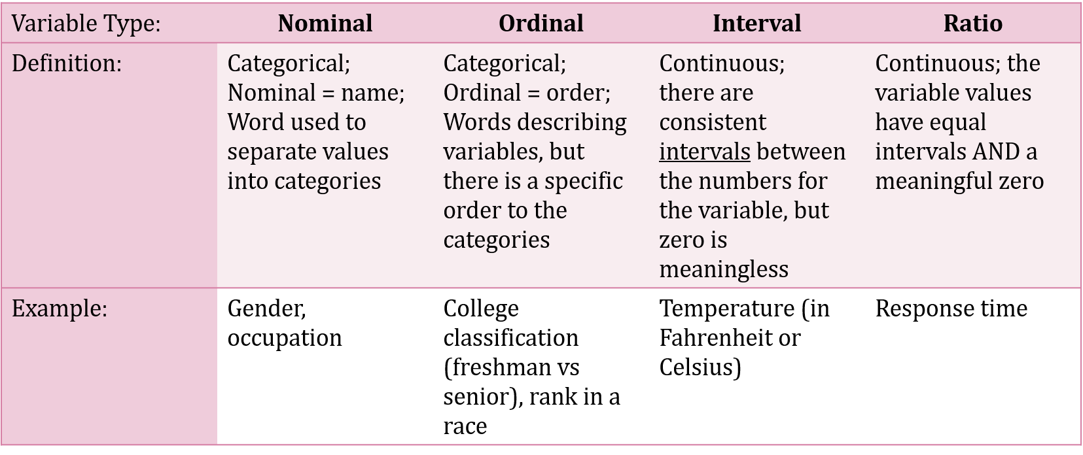
Scales of Measurement

Slide 9
Reliability
Reliability vs validity
Test-retest reliability
Interrater reliability
Internal reliability

Slide 10
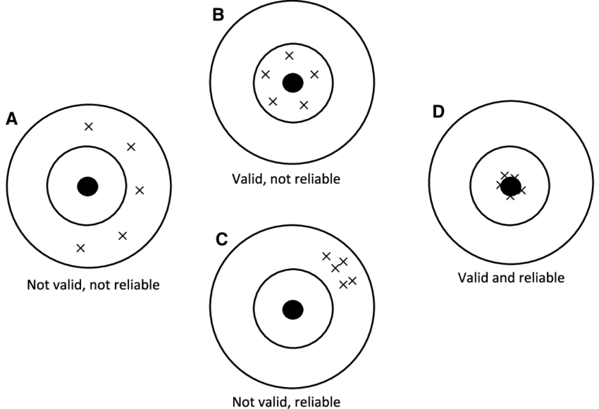
Reliability vs. Validity
Reliability – how consistent the results of a measure are
Validity – whether it’s actually measuring the construct it’s supposed to measure

Slide 11
Test-Retest Reliability
Test-retest reliability – consistent scores every time the measure is used (temporal stability)
Typically assessed with scatterplots and the correlation coefficient (r)
A reliable test will have a strong correlation between a participant’s value at Time 1 and at Time 2
Most common measure for correlation: Pearson’s r
  The sign (+/-) tells you the direction of the relationship (positive, negative, or zero)
  The absolute value tells you the strength of the relationship. The general rule of thumb:
    0.1 - 0.29= small (weak) correlation
    0.3 – 0.49 = medium (moderate) correlation
    Greater than 0.5 = large (strong) correlation

Slide 12
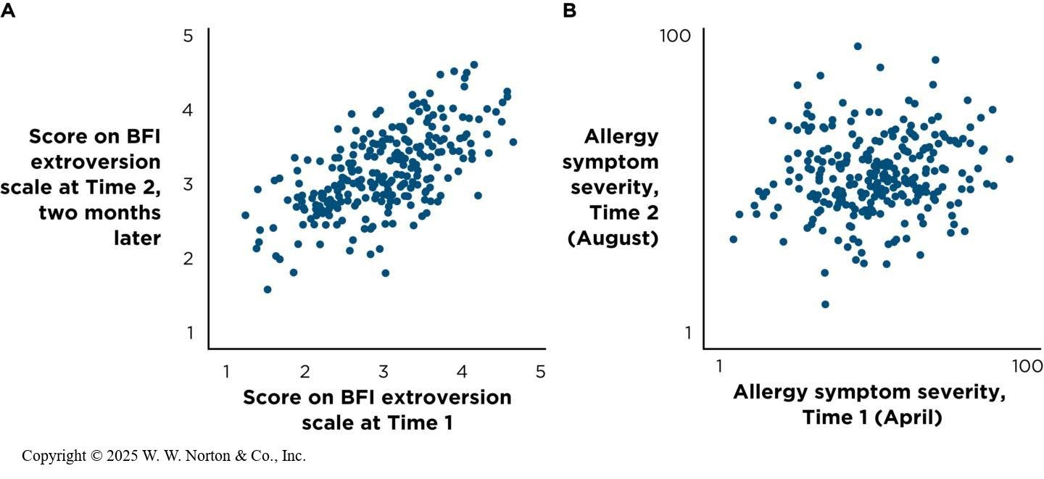
Test-Retest Reliability

Slide 13
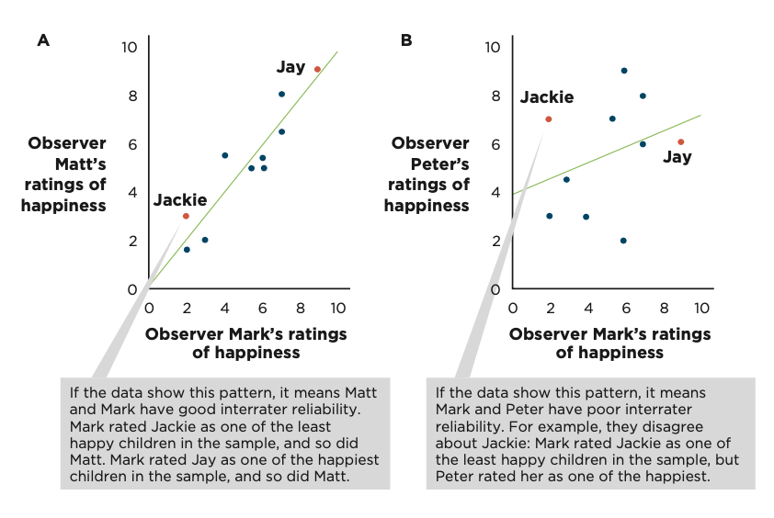
Interrater Reliability
Interrater reliability – consistent scores across different raters
Important for any observational data that is assessed by an “expert”

Slide 14
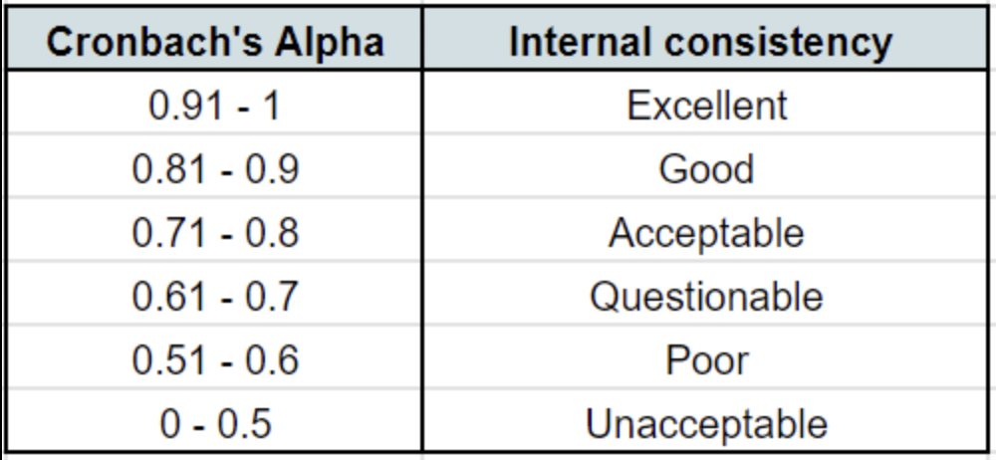
Internal Reliability
Internal reliability (internal consistency) – pattern consistent across multiple items about the same concept
Average inter-item correlation – average of all the correlations between the different items.
Cronbach’s alpha (α) – a function of the number of items and the AIC

Slide 15
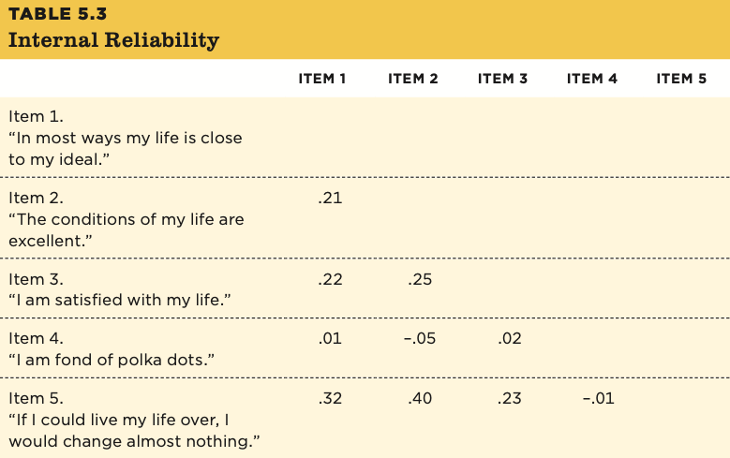
Internal Reliability Comparisons
Ideally, your items that share the same latent variables will be strongly related

Slide 16
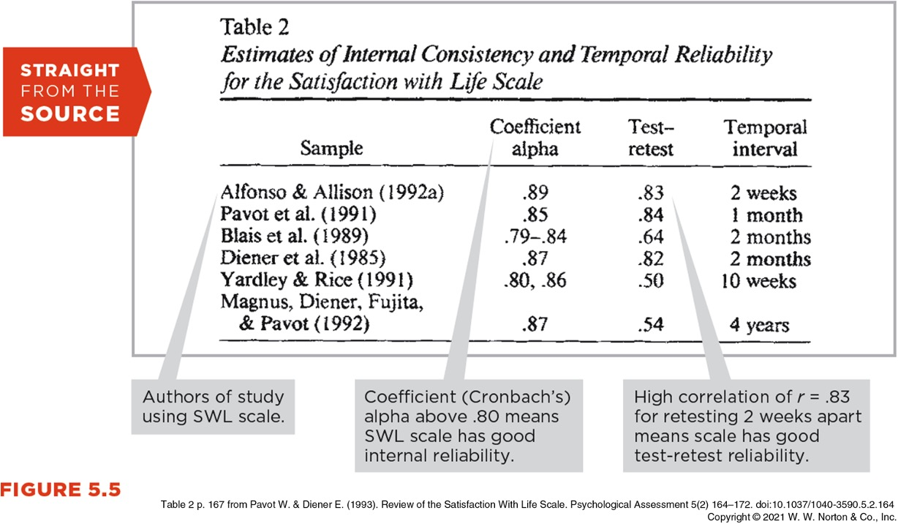
Internal Reliability in Journal Articles

Slide 17
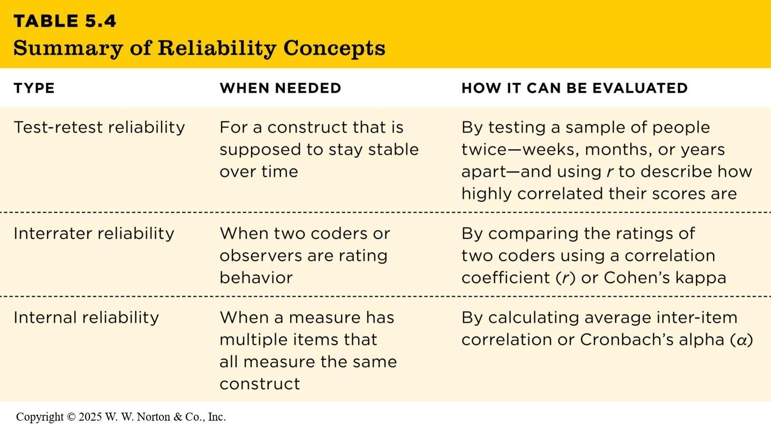
Overview of Reliability

Slide 18
Let’s Review…
Evaluating an Experiment:
  Construct validity – how well the variables in a study are measured or manipulated
  Statistical validity – how well the numbers support the claim
  Internal validity – the extent to which the researcher is confident that one variable caused the second variable
  External validity – the extent to which the results can generalize to a different or larger population
Evaluating a Measure:
  Test-retest reliability – consistent scores every time the measure is used (temporal stability)
  Internal reliability (internal consistency) – pattern consistent across multiple items about the same concept
  Interrater reliability – consistent scores across different raters
  Now, let’s add ways to assess the validity of a measure…

Slide 19
Validity
Face validity
Content validity
Criterion validity
Convergent validity
Discriminant validity

Slide 20
Face Validity and Content Validity
Both face validity and content validity are subjective ways to assess validity.
Face validity – it looks like what you want to measure.
  Ex: Is the item “In the last seven days, how often have you self-harmed?” a reasonable question to ask when we want to assess depression?
Content validity – the measure contains all the parts that your theory says it should contain.
  Ex: Is the item “In the last seven days, how often have you self-harmed?” capturing everything we need to measure depression?

Slide 21
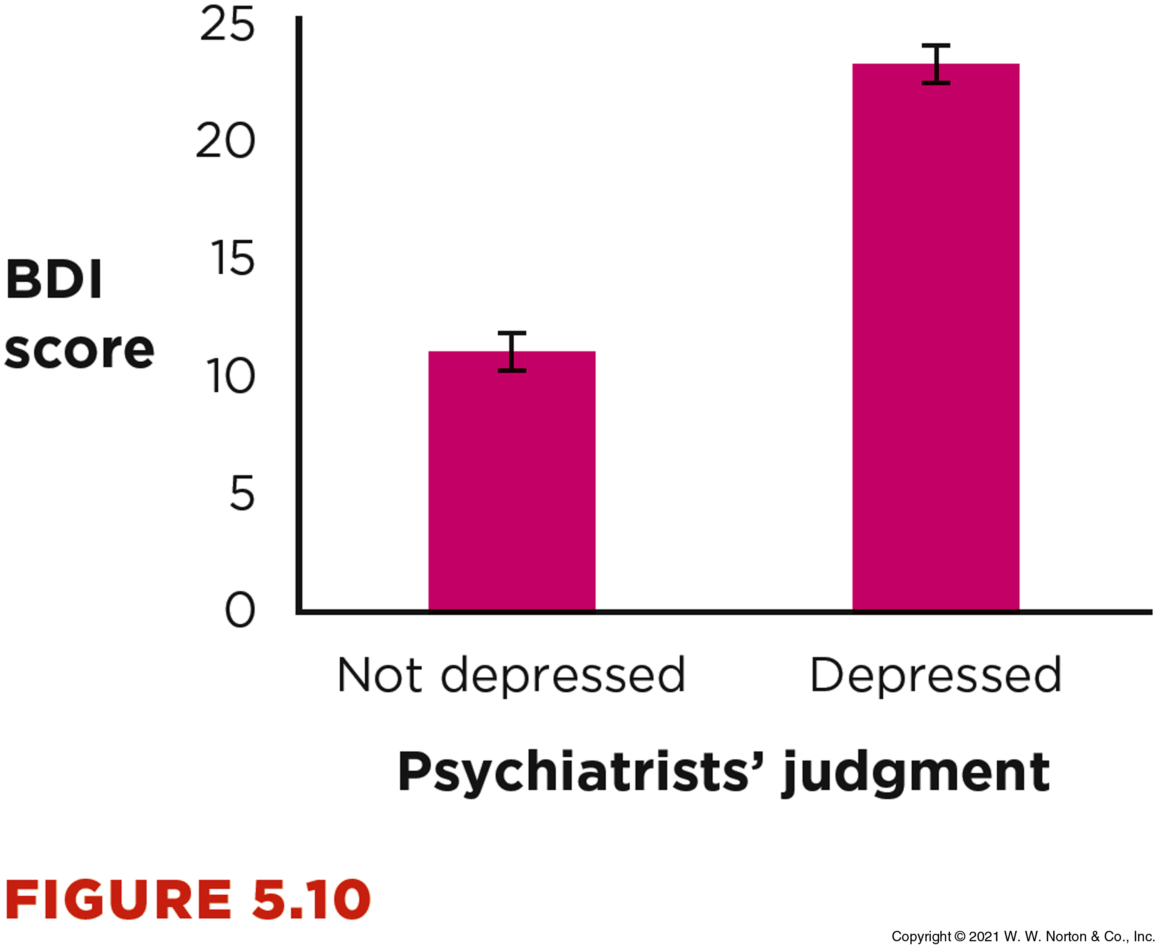
Criterion Validity
Criterion validity – whether the measure is related to a concrete outcome it should be related to
  Commonly evaluated with correlation coefficients
    Ex: Are high school SAT scores correlated with college GPAs?
  Can also be assessed with the known-groups paradigm
    Ex: Evaluating the Beck Depression Inventory between one group that’s been diagnosed as depressed and one who group that is not depressed

Slide 22
Convergent Validity
Convergent validity – a measure should correlate strongly with other measures of the same construct
  Ex: The Beck Depression Inventory should strongly correlate with the Depression subsection of the Depression Anxiety Stress Scale

Slide 23
Discriminant Validity
Discriminant validity (aka divergent validity) – a measure should correlate less strongly with measures of different constructs
  Ex: The Beck Depression Inventory should NOT strongly correlate with the Anxiety subsection of the Depression Anxiety Stress Scale

Slide 24
Multidimensionality
Some measures have multiple concepts that are being represented.
  Ex: The Depression Anxiety Stress Scale has 3 separate concepts: depression, anxiety and stress
For these measures, you will want convergent validity AND discriminant validity within that one measure

Slide 25
Example: Authenticity Scale
w1 I think it is better to be yourself than to be popular.
w2 I don’t know how I really feel inside.
w3 I am strongly influenced by the opinions of others.
w4 I usually do what other people tell me to do.
w5 I always feel I need to do what others expect me to do.
w6 Other people influence me greatly.
w7 I feel as if I don’t know myself very well.
w8 I always stand by what I believe in.
w9 I am true to myself in most situations.
w10 I feel out of touch with the 'real me’.
w11 I live in accordance with my values and beliefs.
w12 I feel alienated from myself.
(Wood et al., 2008)

Slide 26
Authenticity
w1 I think it is better to be yourself than to be popular.
w8 I always stand by what I believe in.
w9 I am true to myself in most situations.
w11 I live in accordance with my values and beliefs.
w3 I am strongly influenced by the opinions of others.
w4 I usually do what other people tell me to do.
w5 I always feel I need to do what others expect me to do.
w6 Other people influence me greatly.
w2 I don’t know how I really feel inside.
w7 I feel as if I don’t know myself very well.
w10 I feel out of touch with the 'real me’.
w12 I feel alienated from myself.
Authentic Living

Slide 27
Authenticity
w1 I think it is better to be yourself than to be popular.
w8 I always stand by what I believe in.
w9 I am true to myself in most situations.
w11 I live in accordance with my values and beliefs.
w3 I am strongly influenced by the opinions of others.
w4 I usually do what other people tell me to do.
w5 I always feel I need to do what others expect me to do.
w6 Other people influence me greatly.
w2 I don’t know how I really feel inside.
w7 I feel as if I don’t know myself very well.
w10 I feel out of touch with the 'real me’.
w12 I feel alienated from myself.
Accepting External Influences

Slide 28
Authenticity
w1 I think it is better to be yourself than to be popular.
w8 I always stand by what I believe in.
w9 I am true to myself in most situations.
w11 I live in accordance with my values and beliefs.
w3 I am strongly influenced by the opinions of others.
w4 I usually do what other people tell me to do.
w5 I always feel I need to do what others expect me to do.
w6 Other people influence me greatly.
w2 I don’t know how I really feel inside.
w7 I feel as if I don’t know myself very well.
w10 I feel out of touch with the 'real me’.
w12 I feel alienated from myself.
Self-alienation

Slide 29
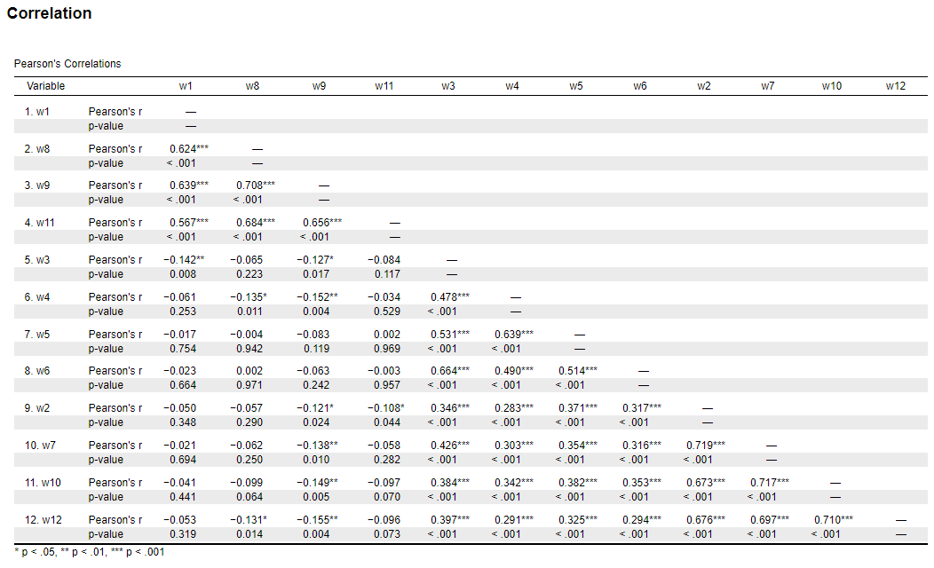
The Pattern Matrix

Slide 30
Pulling it Back Together
  The validity of a measure is not the same as its reliability.
  A measure can be less valid than it is reliable, but it cannot be more valid than it is reliable.
  Reliability is necessary but not sufficient for validity.

Slide 31
Next Time on PSY 270…
Before Next Class(es):
Read Chapter 5 and complete Ebook: Chapter 5 assignment
  Due 9/30 at 11:59 pm
Complete InQuizitive: Chapter 5
  Due 9/30 at 11:59 pm
Next Class:
Chapter 6: Surveys and Observations

